Slide 1
Games Bootcamp Level Design

Slide 2
Table of contents
01
Level Design
04
Unity Tools
02
Destination & Objectives
03
Building Blocks of Levels
Difficulty, Flow, Hooks and Rhythm
Terrain, Prefabs, ProBuilder
Setting Objectives, Mission Structure and Feedback
Mechanic Modifiers Modes Blockers

Slide 3
01
Level Design

Slide 4
Why Do I Hear
Boss Music?

Slide 5
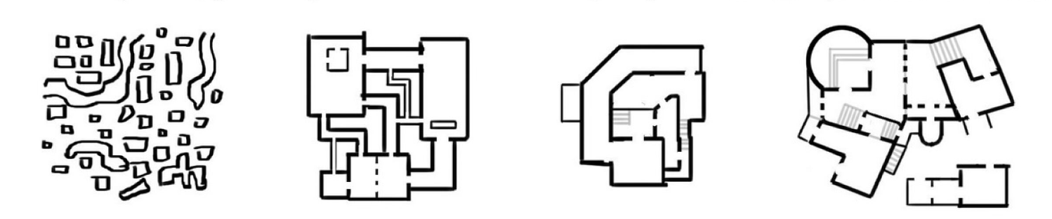
Level Layout (1)
Beginner
Intermediate
Advanced
Expert
No clear flow or differentiation.
No attempt to break lines of sight.
Room-hallway-room syndrome
Some theory knowledge but applied very literally.
Simple & memorable
Mix of height
45 degree feels very video-gamey.
Purposefully breaks,
Real-life inspiration.
Breaks line of sight
Notes:
rable.

Slide 6
Level Design Principles
Difficulty
Rhythm
Flow
Hooks
Keeping Players Challenged
Varying the Player Experience
Keep Players moving towards the Goal
Making Levels Different
Notes:
1. Difficulty - Keep players challenged
Example: In the "Super Mario" series, earlier levels introduce basic mechanics, like simple jumps and enemies. As the player progresses, levels introduce more complex platforming challenges, more dangerous enemies, and intricate puzzles. By the end, players might face multi-stage boss fights or time-constrained challenges, testing the skills they've developed.
2. Rhythm - Vary the player experience
Example: In many "Call of Duty" campaigns, players might experience a rhythm where they engage in a high-adrenaline firefight, followed by a stealth segment, then a narrative cutscene, and finally an exploration or puzzle-solving section. This variation ensures that players don't become too fatigued with one style of gameplay.
3. Flow - Keep players moving towards the goal
Example: In "The Last of Us," players are often guided through levels using visual cues. A lit doorway in a dark room, a conspicuously placed ladder, or a signpost in a dilapidated city all guide players towards their next objective. While there's room to explore, these cues help ensure players never feel completely lost.
4. Hooks - Making levels different
Example: In "The Legend of Zelda: Ocarina of Time," each dungeon has a unique theme and mechanic. The "Forest Temple" is haunting with its eerie music and ghostly foes, and it introduces the mechanic of twisting corridors. The "Water Temple," on the other hand, is infamous for its water level puzzles. These thematic and mechanical hooks make each dungeon distinct and memorable.

Slide 7
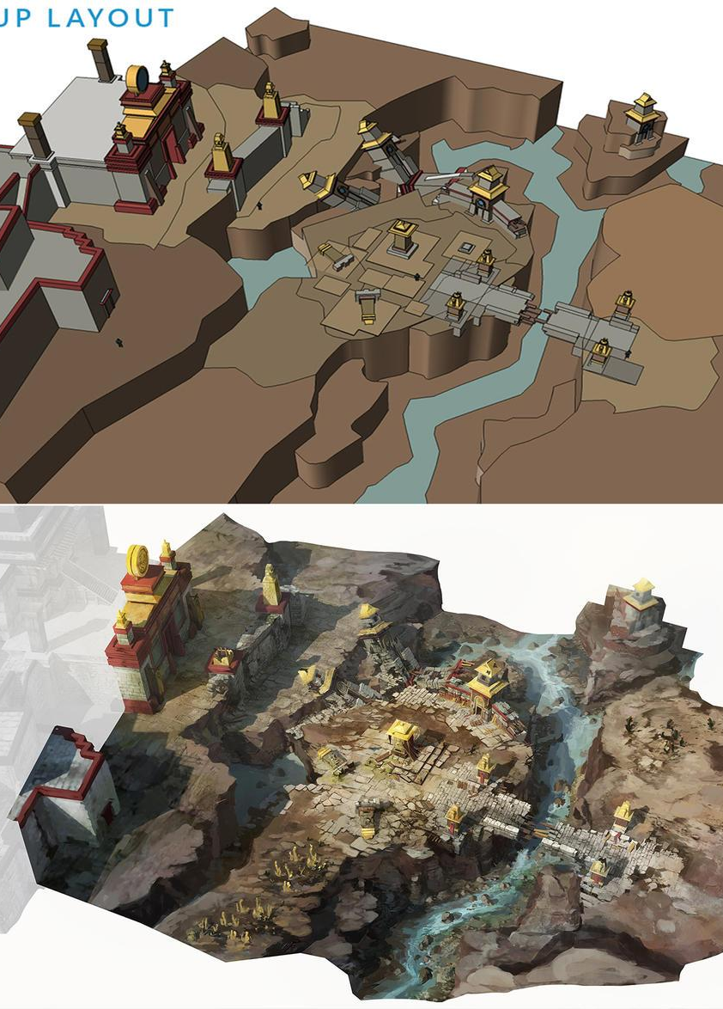
Level Layout (2)
Guiding the Player
Coherent Experience: Every segment of the level should tell a part of the story or challenge.
Clarity: Players should have a sense of direction and purpose.
Visual Cues: Use lighting, architecture, and in-game assets to subtly guide the player.

Slide 8
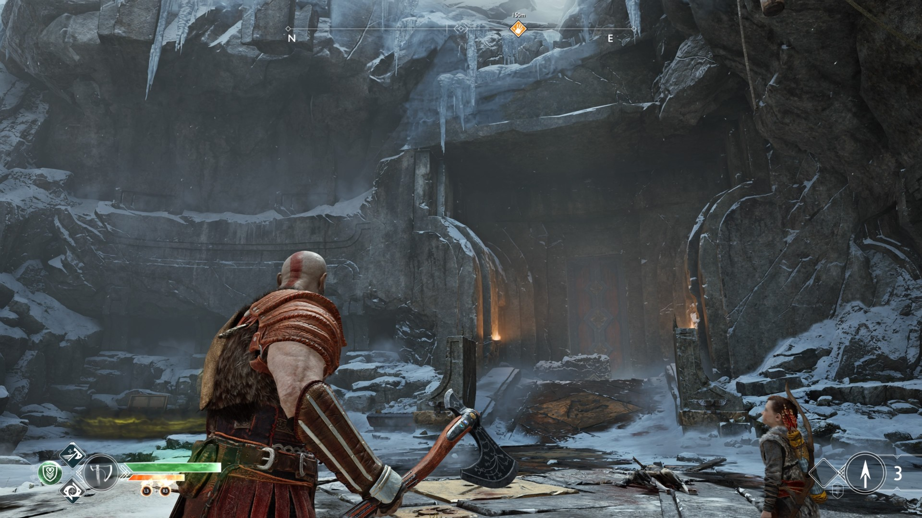
Level Layout (3)
Hierarchy
Primary paths: clear signposting through lighting, textures and narrative cues
Secondary areas: off the beaten path. Stand out from the rest of the scenery but are not the focal point of attention.

Slide 9
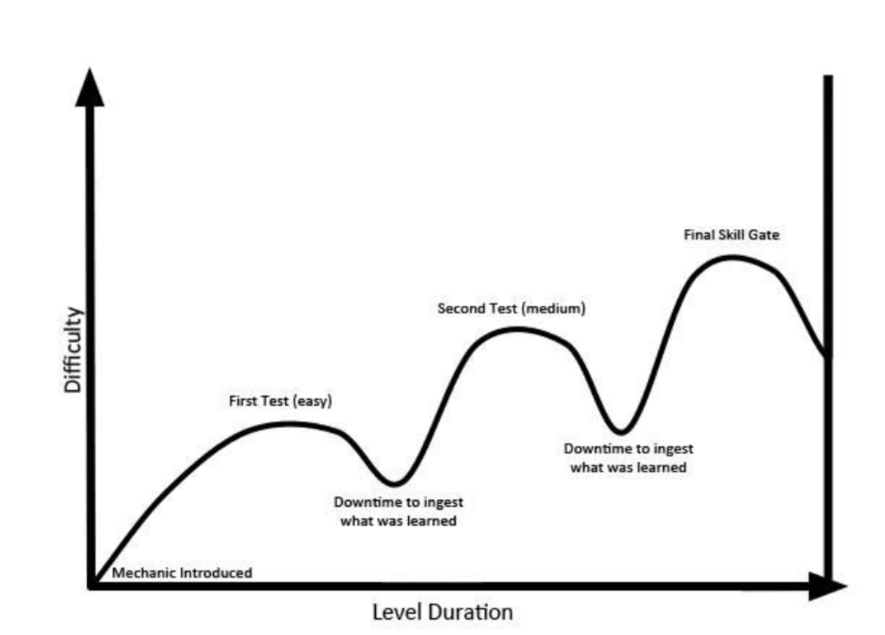
Level Layout (4)
Genre Specificity
RPG: vast open world, points of interest are usually easy to spot structures. RULE OF 30 seconds.
FPS: Competitive nature, line-of-sight and 50-50 scenarios.
Hyper Casual: consistent theme and gradual progression.

Slide 10
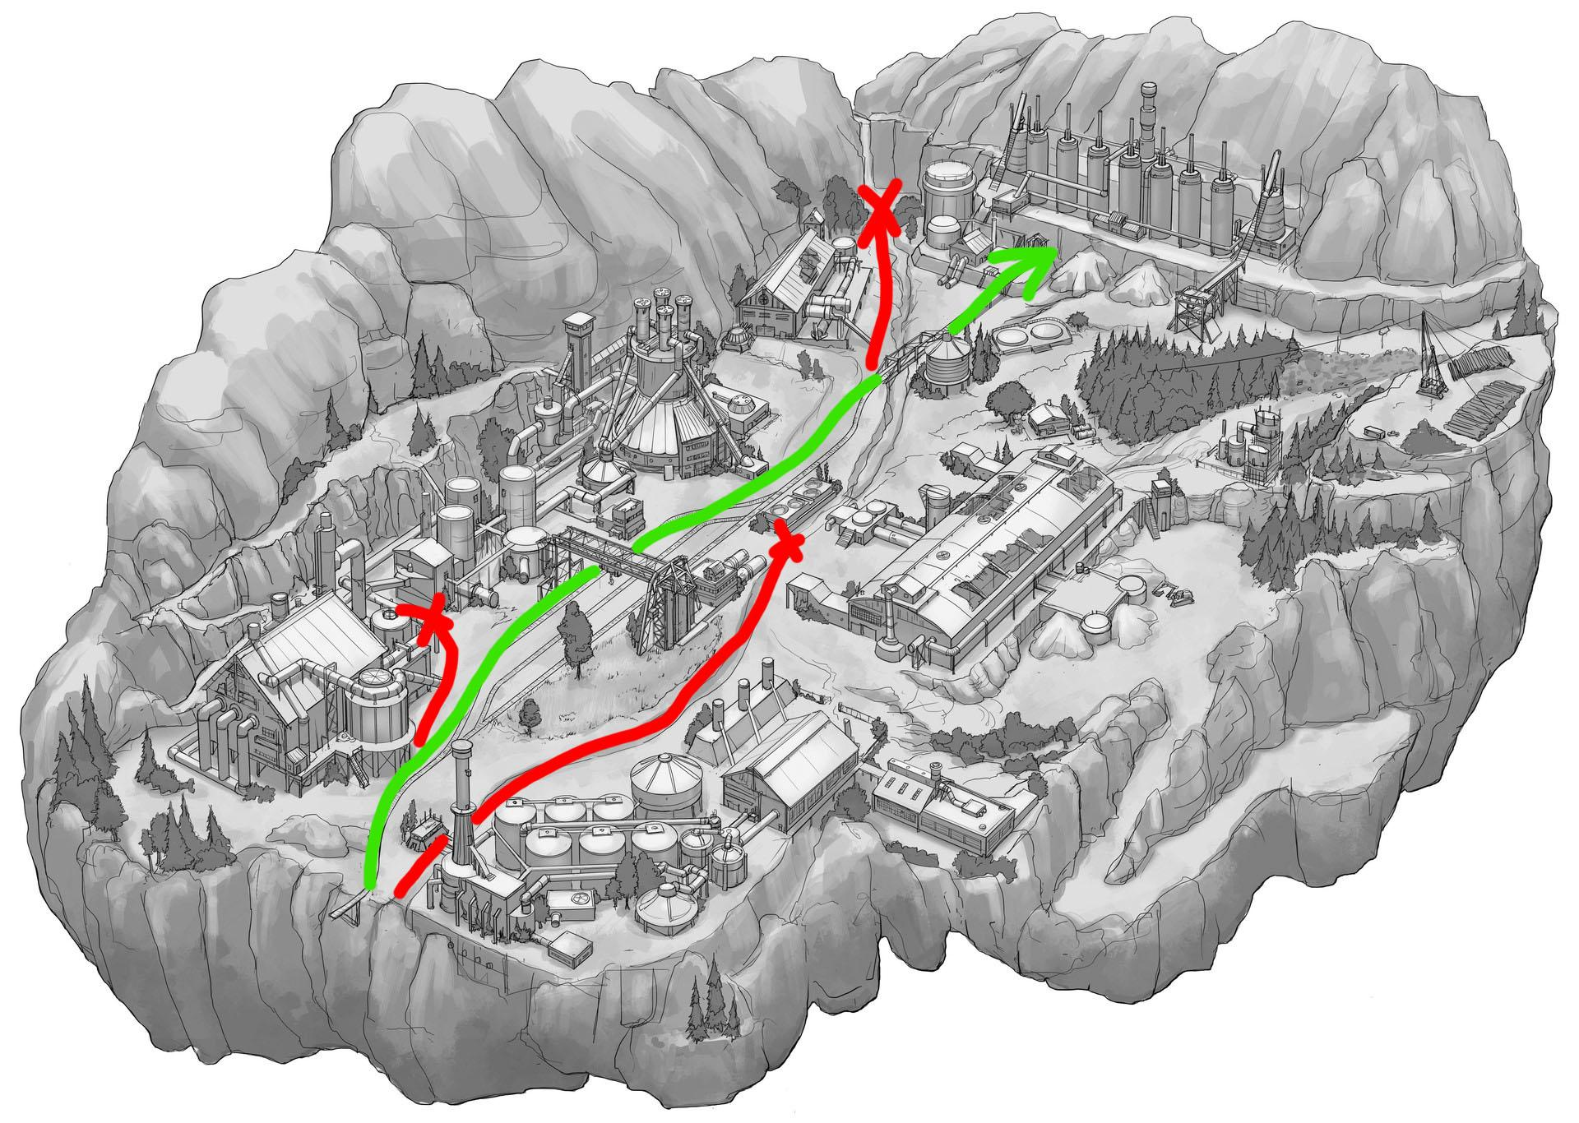
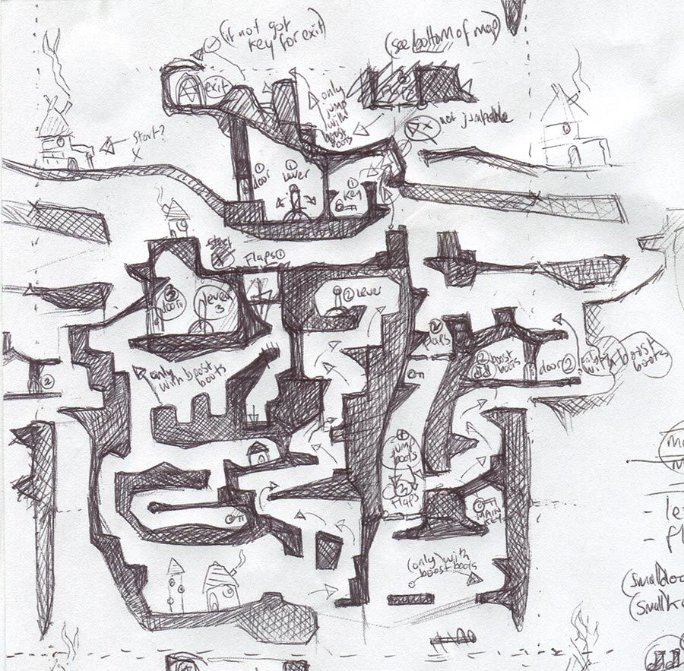
Level Layout (5)
Setting Objectives:
Direction & Purpose: clear objective to strive towards.
Variety: path to objective gives chances for exploration combat and problem solving
Integration: objectives should feel like a natural part of the game world.

Slide 11
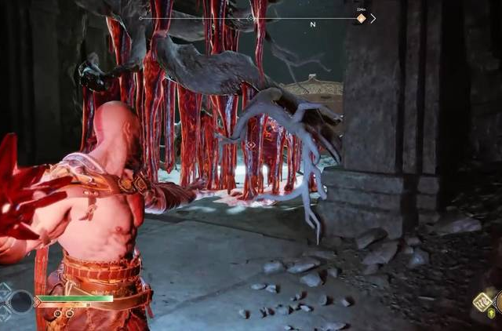
Level Layout (6)
Mission Structure
Building Blocks: each objective is a stepping stone towards completing the level.
Cohesion: Objectives should feel interconnected.
Investment: discoveries make the world more explorable.

Slide 12
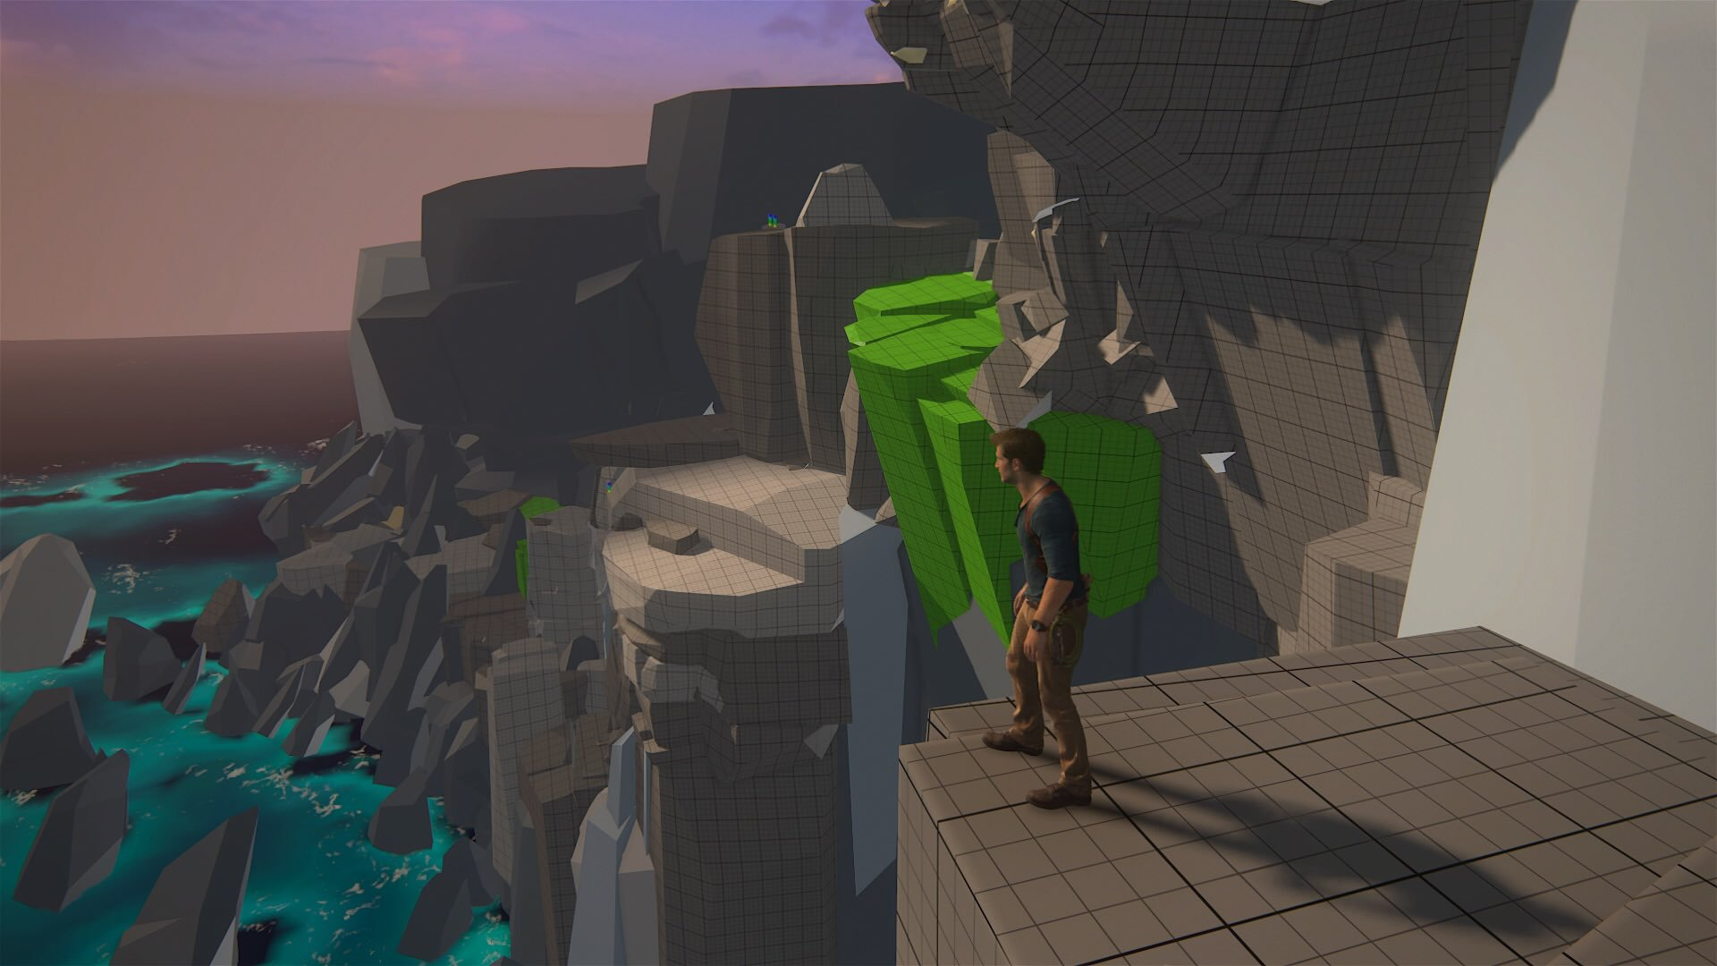
Greybox Levels

Slide 13
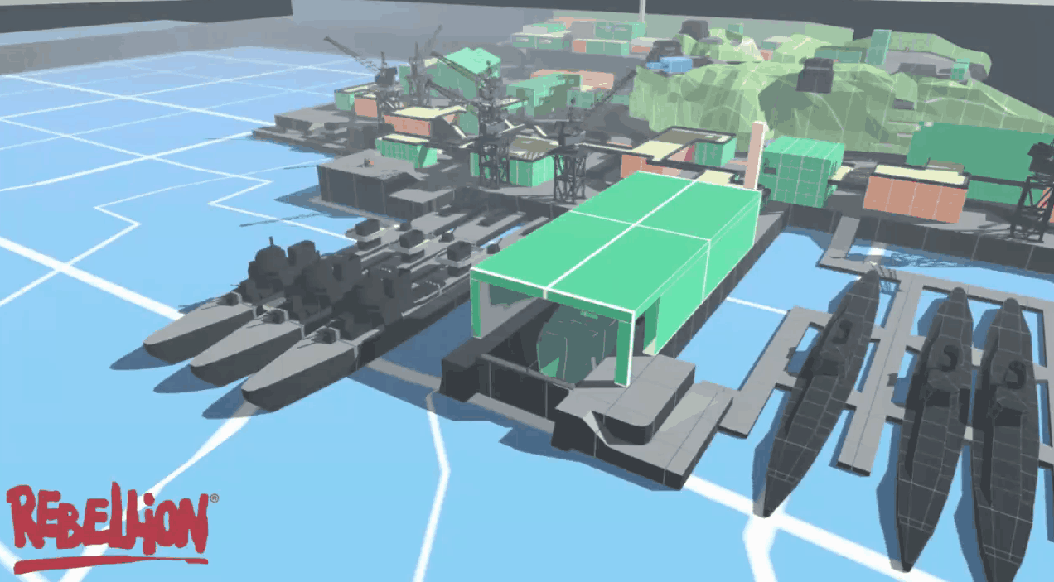
Iteration

Slide 14
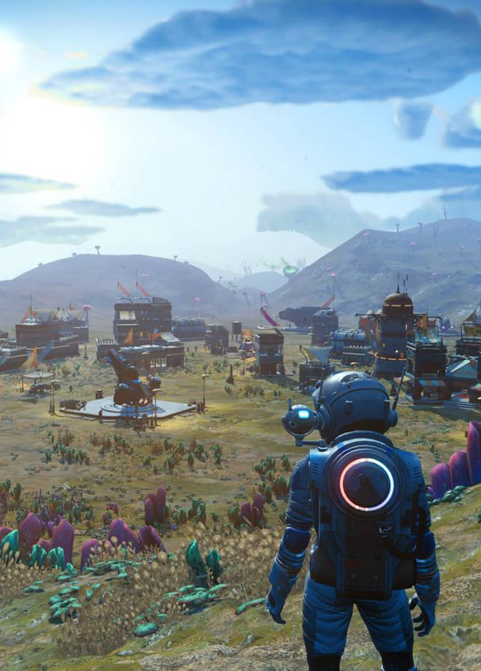
Procedural Levels
Hand-Crafted
Control: gameplay mechanics, story elements, and visual aesthetics are hand-picked.
Consistency: each playthrough of the level is the same.
Narrative Integration: It's easier to weave a narrative or story elements into hand-crafted levels.
Procedural:
Replayability: players encounter different level layouts or challenges each time they play.
Endless Content: Ideal for games that aim to provide infinite or endless content
Efficiency: it can create numerous levels without manual input, potentially saving development time in the long run.

Slide 15
03
Building Blocks of Levels

Slide 16
Where will you play the game?
Who is your audience?
What emotions do you want to evoke?
How will you teach or guide the player?
What are the short-term rewards?

Slide 17
Building Blocks of Witcher 3
Game Mechanics
Sword Attacks
Potions
Crafting
Gameplay Elements
Toxicity
Health
Stamina
Modifiers
Effects of Potions
Buffs
Penalties
Game Modes
Brawling
Human Fighting
Monster Fighting
Blockers
Points of Interest
Enemy Spawns
Battle Stages

Slide 18
04
Unity Tools
ToTerrain, V Shortcut, Prefabs, ProBuilder

Slide 19
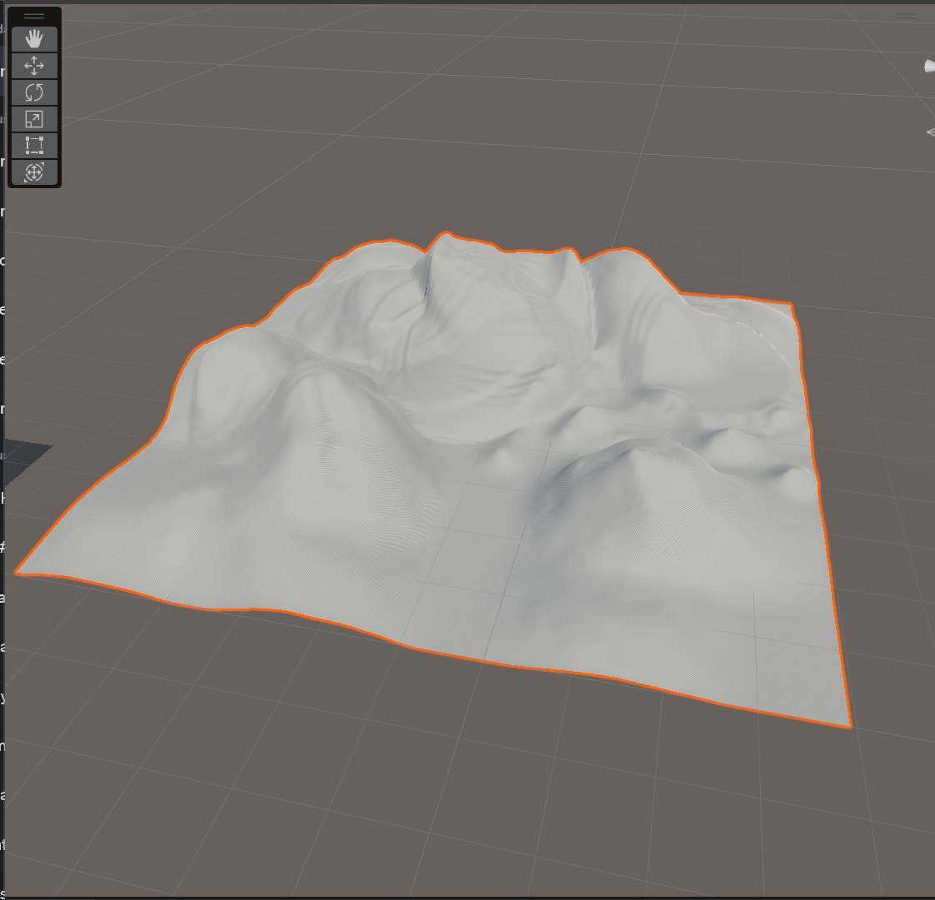

Unity Terrain:
Allows developers to create expansive, natural-looking outdoor environments. It provides a set of tools to sculpt, paint, and detail landscapes, turning a flat plane into rolling hills, mountains, valleys, and other natural terrains.

Slide 20


Slide 21
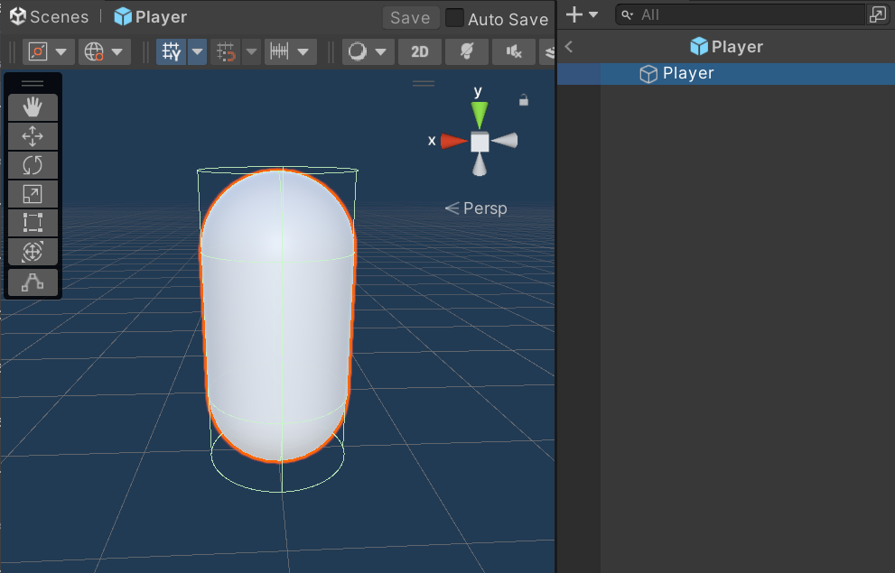
Prefabs:
Prefabs are reusable asset templates in Unity. They streamline asset management and save time by allowing designers to update multiple instances simultaneously.

Slide 22
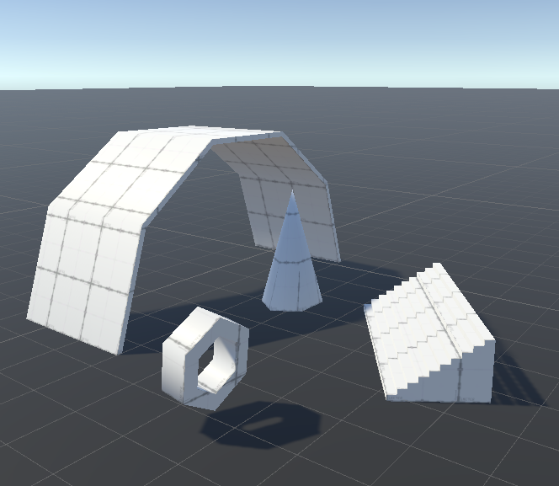
Unity ProBuilder:
Unity ProBuilder is a powerful tool for rapidly prototyping and constructing 3D environments. It Allows you to create and modify various primitive shapes.

Slide 23
Thanks!

